Slide 1
Pew Charitable Trusts Study
How States Use Data to Inform Decisions
The First comprehensive overview of data utilization in all 50 states includes study of:
  Data use and benefits.
  Data analysis.
  Data infrastructure.
  Supports and challenges of data work
Notes:
February, 2018

Slide 2
According to Pew, jurisdictions use data to:
Cross-reference data sets
Use calculations to show trends
Find correlations between factors
Visualizing data in charts and graphs

Slide 3
Jurisdictions should…
Set up guiding goals and structures
Build capacity of stakeholders to effectively use data
Ensure quality data can be accessed and used by stakeholders
Analyze data to create meaningful information
Sustain support for continued data efforts
Notes:
IFTA can provide support for items in red

Slide 4
Key factors in the Use and Analysis of Data
Leadership
Appropriate Staffing
Data validity and accessibility

Slide 5
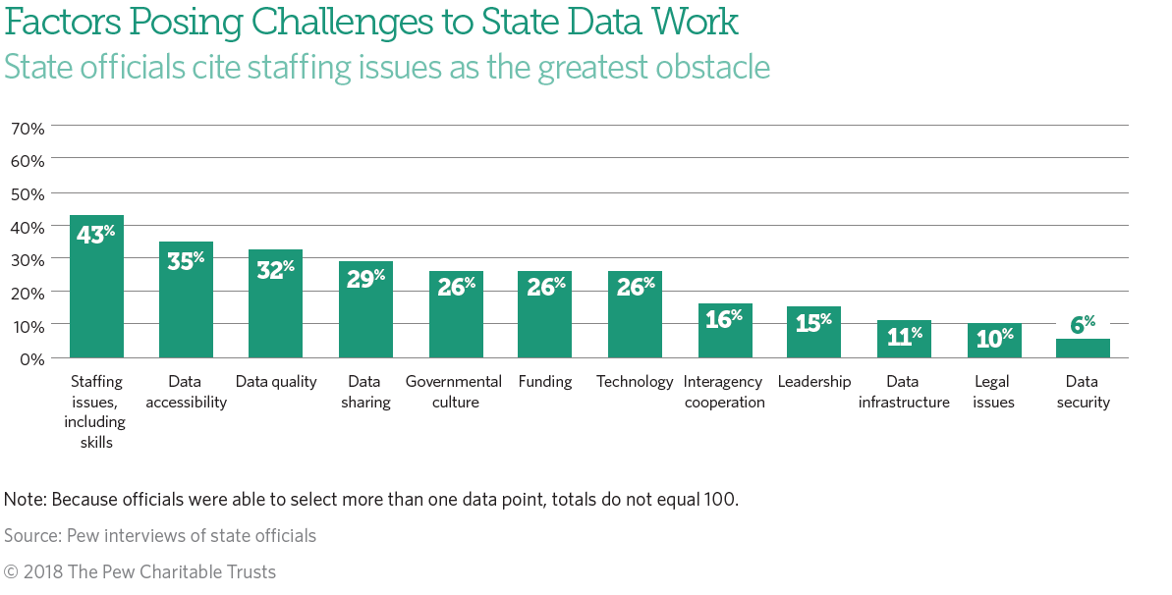
Notes:
IFTA can support efforts in data accessibility, quality and sharing

Slide 6
Transforming Data
Validated Fuel, Distance and Tax Data
Data Analytics
Information for Decision Making
Notes:
To transform data into valuable information, the data must be validated, analyzed and transformed into useful information

Slide 7
IFTA’s Role in Data-Based
Decision Making
Validate
Disseminate data through the Clearinghouse Reports
Provide information-sharing platform

Slide 8
IFTA Data Validation
Should IFTA validate transmittal data received from jurisdictions?
What validations should be performed?
  Incorrect information in defined fields?
  MPGs too high?
If jurisdictions’ data cannot be validated, should it be rejected or should a warning be issued?

Slide 9
Valid and Useful IFTA Data
The Demographic and Transmittal Databases receive much useful data from member jurisdictions. Many jurisdictions have validation processes built into their organizations.
And, yet, the Demographic and Transmittal Databases do receive some suspect data…

Slide 10
Jurisdictional Example #1
A jurisdiction encountered difficulty loading IFTA Transmittal data into their vendor’s system, due to demographic information populating transmittal fields.
The amount of time spent correcting the incorrect data fields was expensive and the effort was frustrating.

Slide 11
Jurisdiction Example #2
After a fuel tax rate change, a jurisdiction wanted to verify that the change resulted in the expected revenue change.
IFTA data was not sufficient to determine the answer.

Slide 12
After the data is validated at the jurisdictional and IFTA-level…
It must be presented in a clear and useable format for jurisdictional analysts.

Slide 13
IFTA Data Presentation
Data
Dashboard
Charts
Infographics
Reports

Slide 14
Who can use IFTA data to make decisions?
Legislators
Policy Analysts
Executive management
Audit managers
Administrative managers

Slide 15
Data Analytics
How is a revenue stream affected?
  Before/After comparisons
  Experiences from other Jurisdictions
  Experience from different fleet sizes
  Interstate vs Intrastate fleet comparisons
Is our resource allocation appropriate?
What compliance lessons can be learned from data?
Notes:
Before and after a change-tax rate change, toll-road change, vehicle mileage tax change, mpg mandates

Slide 16

IFTA Information Sharing
IFTA can establish an information-sharing platform to encourage jurisdictions to share experiences and expertise in data-based decision making.

Slide 17
Jurisdictional Common Experiences
How can jurisdictions share data experiences?
Roundtables
Message Boards
Conference Calls
Training

Slide 18

How can your jurisdiction better use data?

